Slide 1

COVID-19
Group 11
Tobias Judd , Pankaj Tahiliani,
Patricia Mobolade, Jennifer Darby

Slide 2
Project Overview
The COVID-19 outbreak has impacted the lives of billions of people.
As of today the US has had 6.88M Cases and 200K deaths.
Both Federal and State Governments have implemented various health policies and travel restrictions, leading to disruption in everyday life, and causing frustration / anxiety among citizens.
The project team was interested in understanding the following:
What geographies most affected by COVID Cases?
Does wearing a mask impact COVID numbers?
How does mobility correlate with the COVID rate over time?
Does median income impact the rate?

Slide 3
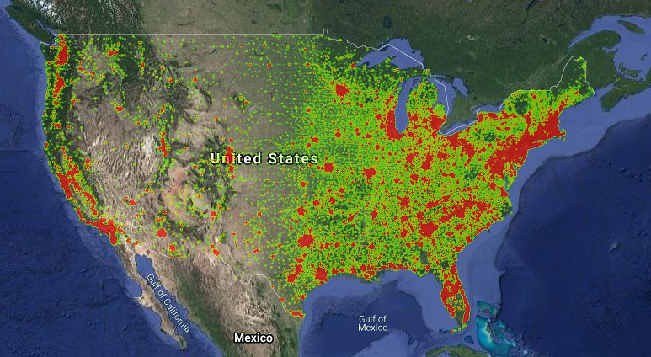

Data Population Sources
Census Data
US Census Data from 2018
Included Population, Income, Work / Commute Style information at county / zip code level.
Reported at the FIP / County level.
Weather
Mask Wearing
Survey data conducted by NY Times and Dynata
Based at FIPS level. Macro view at county level.
Apple Mobility
Covid19.apple.com
Early time data was influenced by local transmission rate.
Reporting guidelines varied due to lack of Federal Recommendations.
Partnership between Google and Apple.
Potential contact tracing based on Bluetooth technology on mobile devices.
COVID Case
Collected the latitude and longitude for primary keys of all data.
Source: Population Heatmap from 2018 Census Data

Slide 4
COVID Timeline – Year 2020
March
September
April
May
June
July
Aug
Global Pandemic
Declared
Last Date of
Data Collection

Slide 5
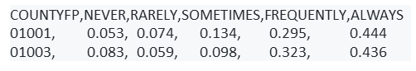
Mask Wearing Patterns for top 100 counties (cases) in March & September
New York Times released estimates of mask usage based on counties in the United States.
This data comes from a large number of interviews conducted online by the global data and survey firm Dynata
The firm asked a question about mask use to obtain 250,000 survey responses between July 2 & July 14
Below is the response structure of the interviews based on the share of the people who would respond with one of the following (never,rarely,sometimes,frequently,always) when asked if they would wear a mask

Slide 6
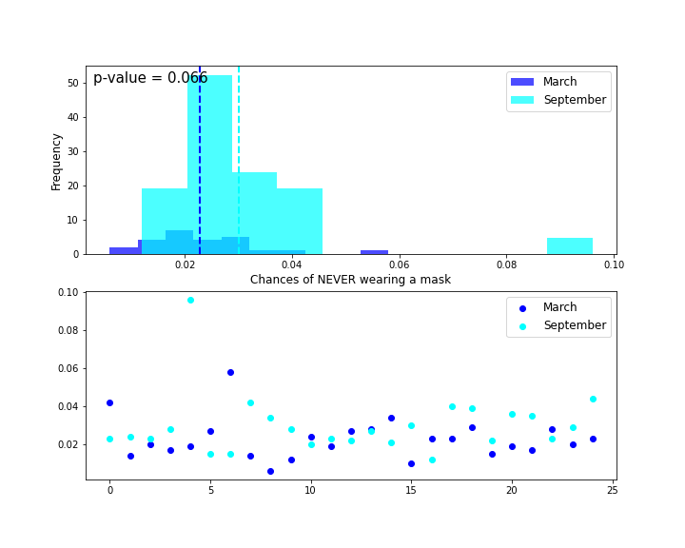
Never Wear A Mask
H₀ : There is no change in mask wearing patterns in the two populations H_{A} : There is a change in the mask wearing patterns in the two populations
Mean_{march} = .02
Mean_{sept} = .03

Slide 7
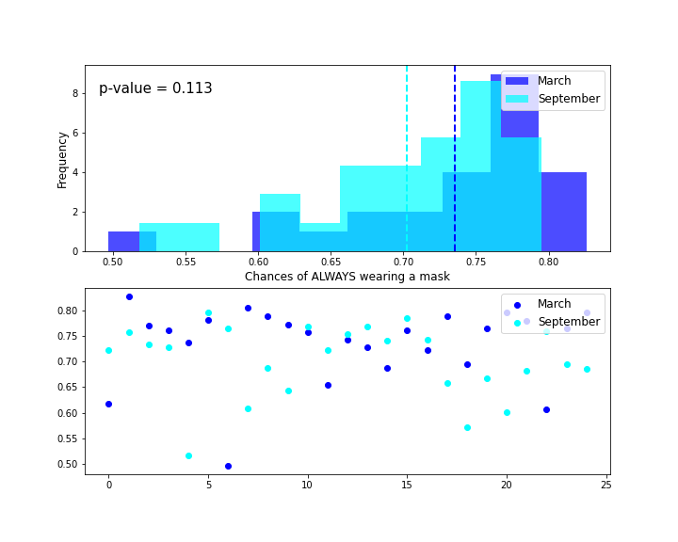
Always Wear A Mask
Mean_{march} = .73
Mean_{sept} = .70
Since (p -value >.05) in both cases, we fail to reject the null hypothesis. Conclusion – There was not enough evidence to prove that the mask wearing patterns have changed in the two populations.

Slide 8
COVID Timeline – Year 2020
May
September
March
April
June
July
Aug
High Frequency
US Data Collection
Last Date of
Data Collection

Slide 9
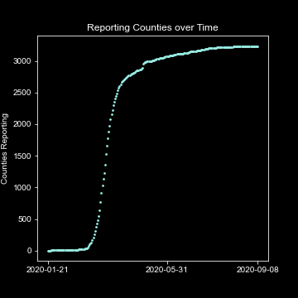
REPORTING INCREASED OVER TIME…

Slide 10
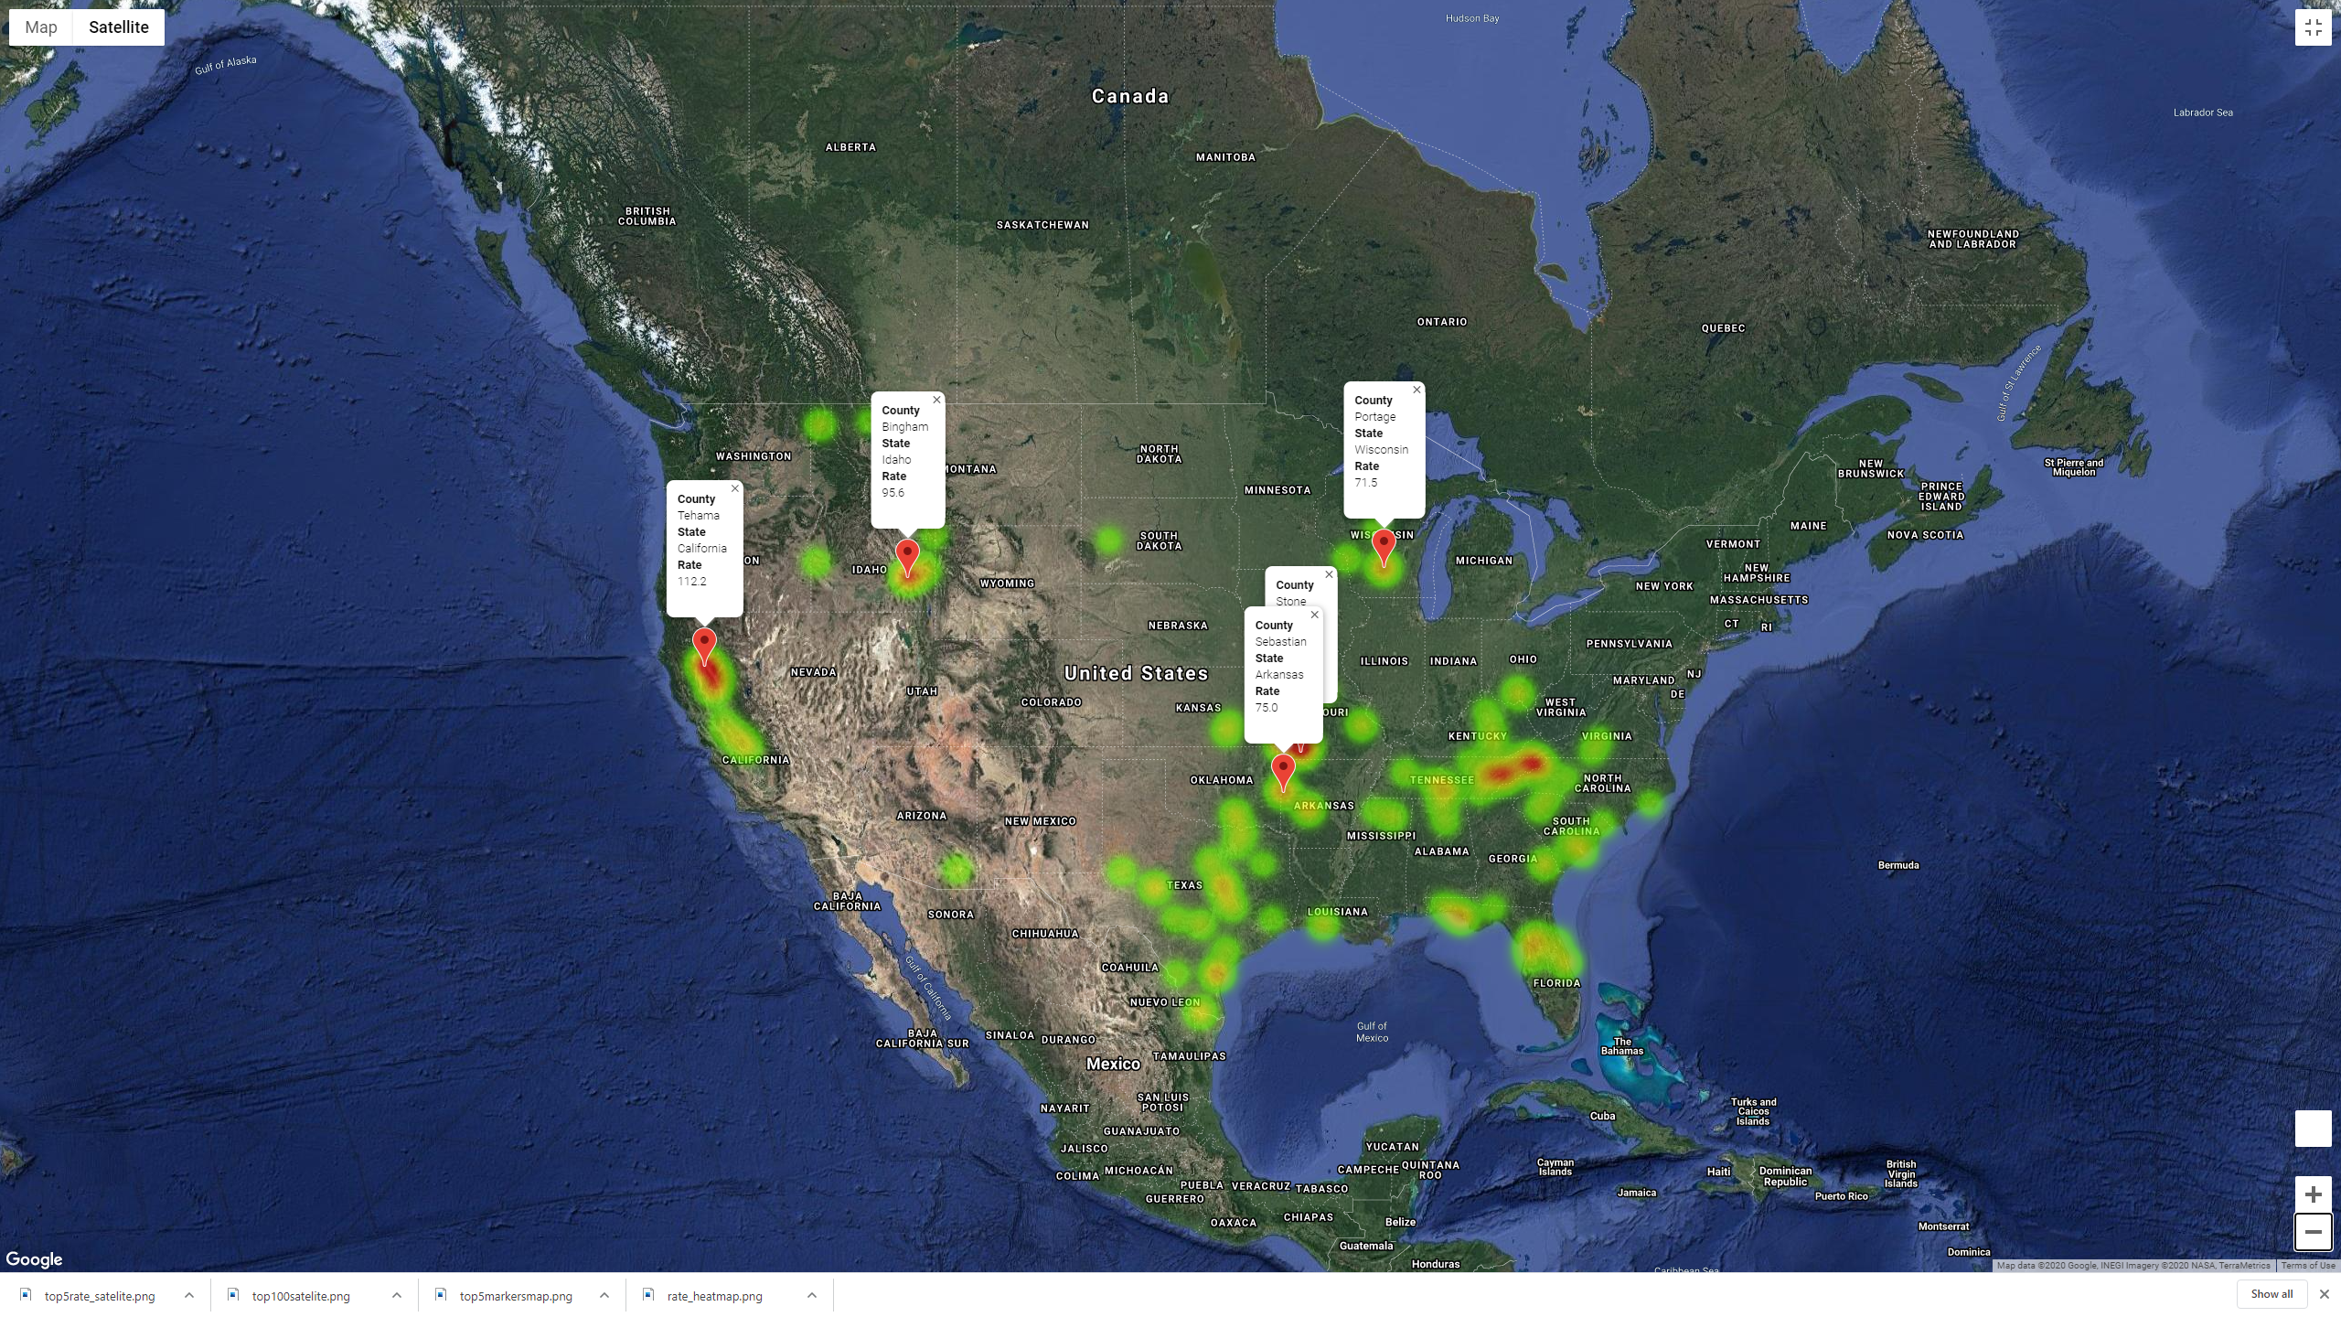
TOP Five - Intensity by COVID Rate
TOP 100 COUNTIES
Heatmap by Rate
Rate of Change
Cases(Sept) – Cases(May)
Cases(May)

Slide 11
COVID Case Trends vs. Mobility Trend for Top 5 Counties by Case Rate
Apple Mobility data reflects the change in driving routing requests over time using January 13, 2020 as its base line
January 13, 2020 - the first date of the first confirmed case outside of China
H₀ : There is no correlation between mobility rates and COVID rates H_{A} : There is a correlation between mobility rates and COVID rates

Slide 12
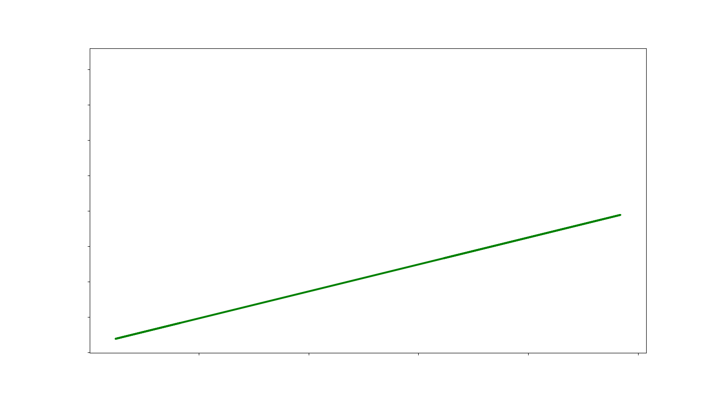
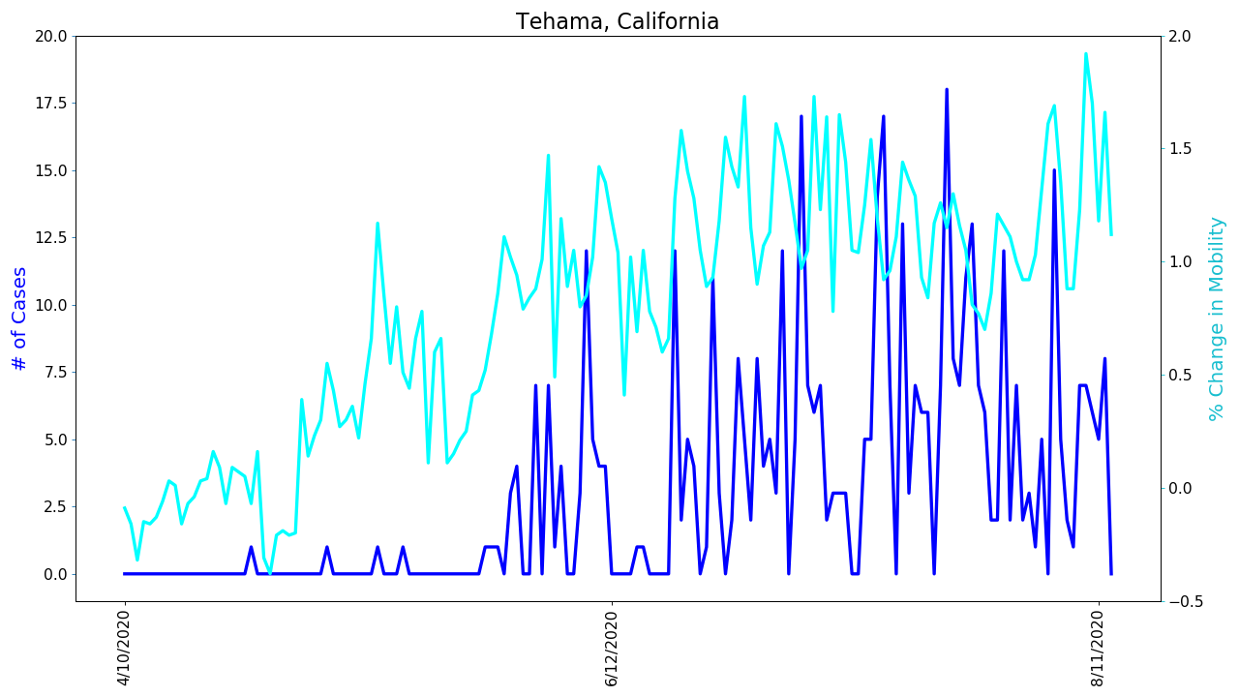
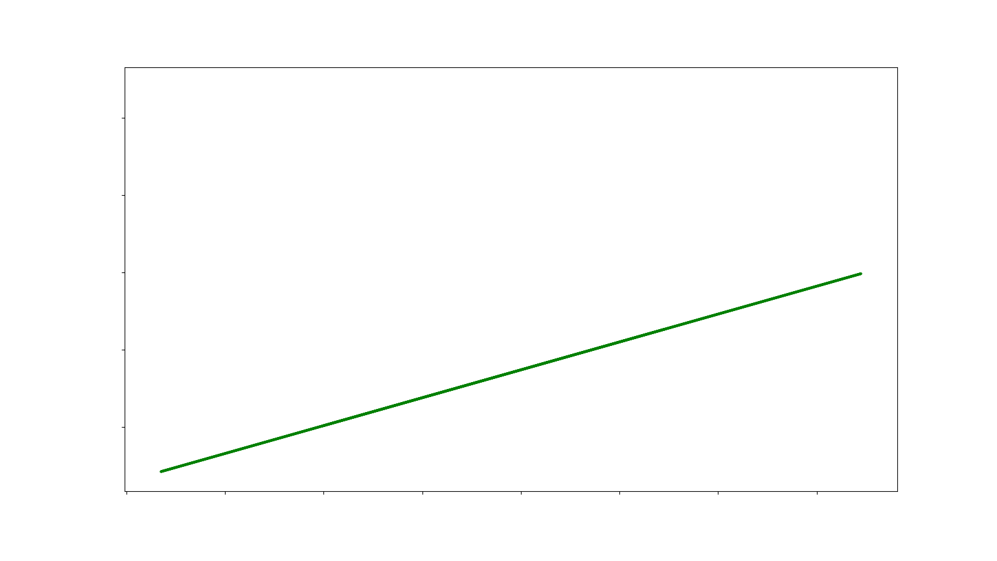
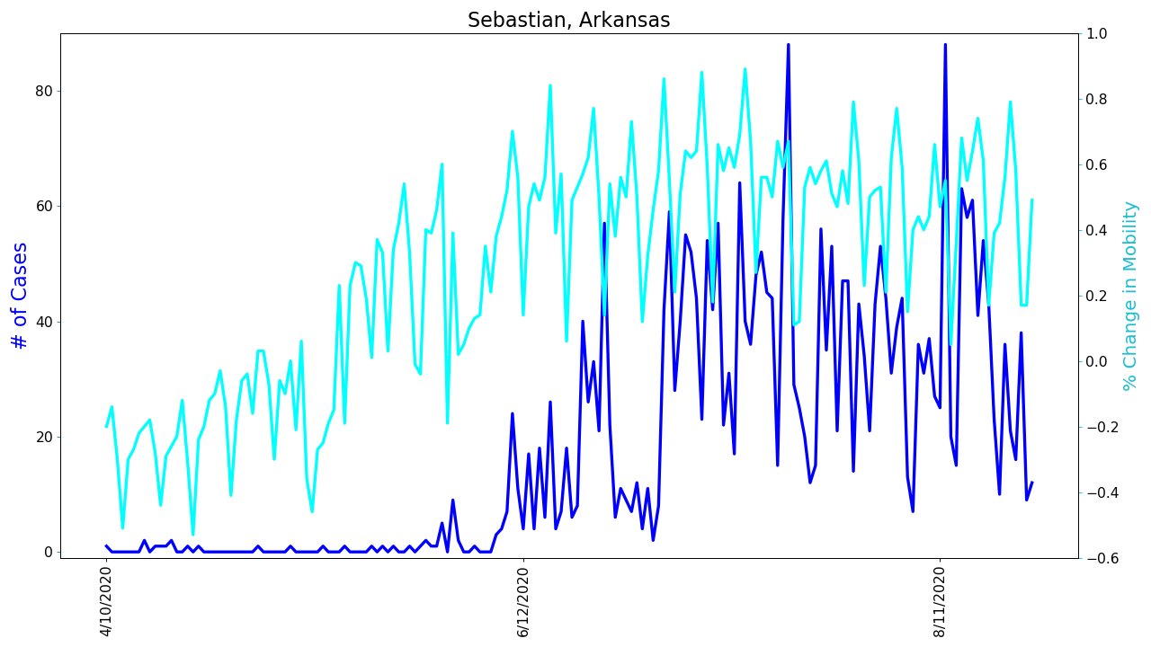
COVID Cases vs. Change in Mobility
Correlation 0.5081906751648264,
P-value 1.0890313493377746e-11)
Correlation 0.6037963663934813
P-value 1.8265989941223974e-18)
y = 36.03x + 7.58

Slide 13
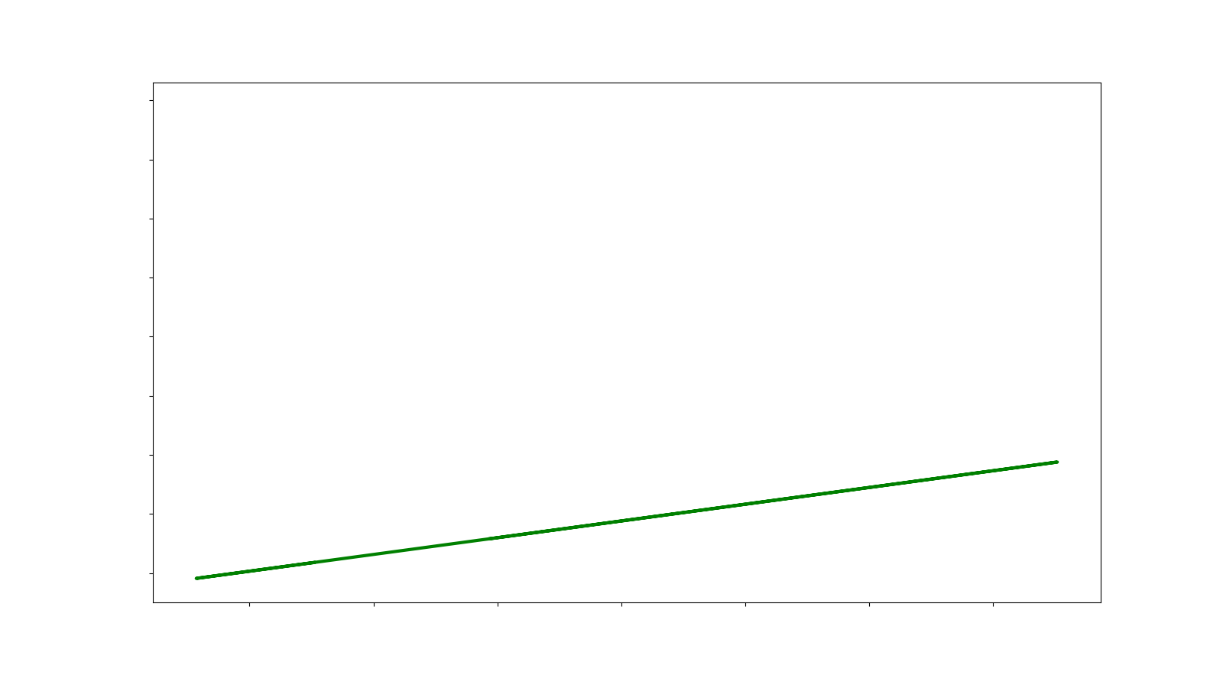
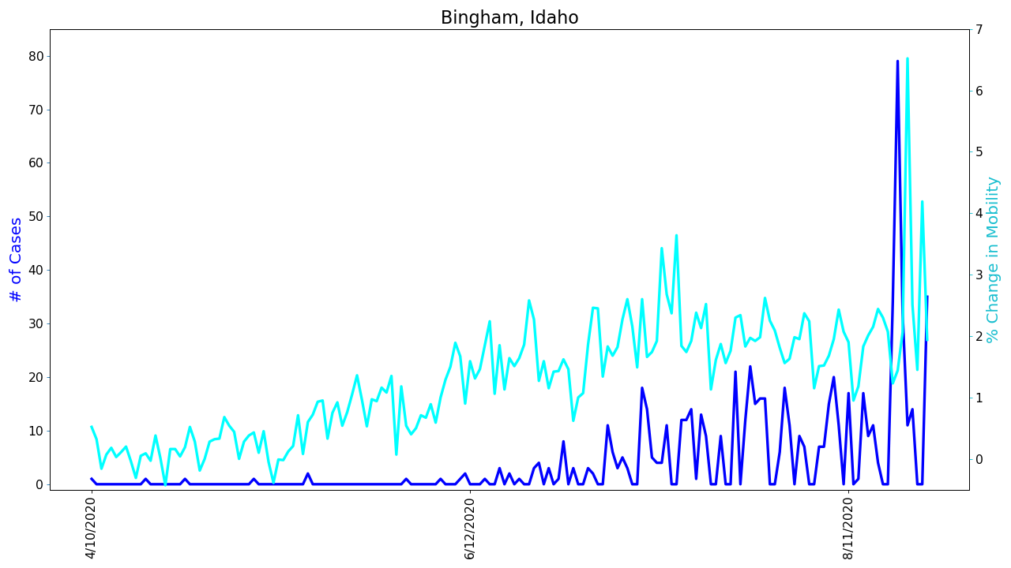
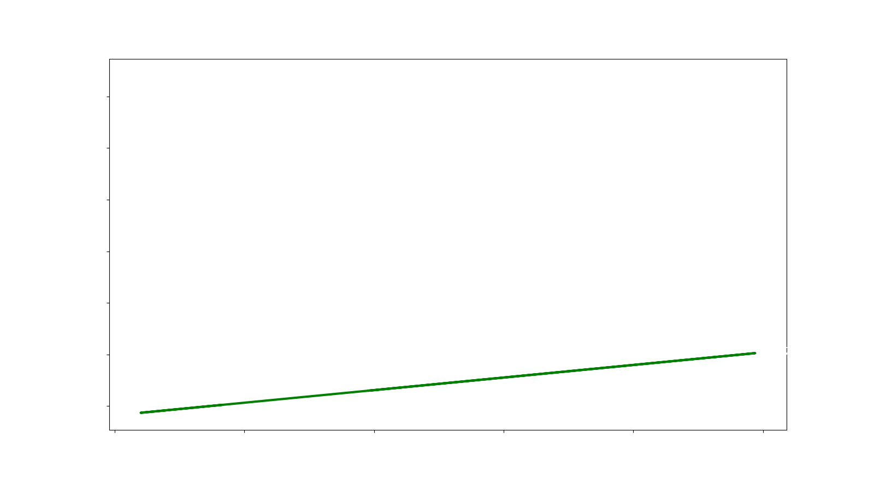
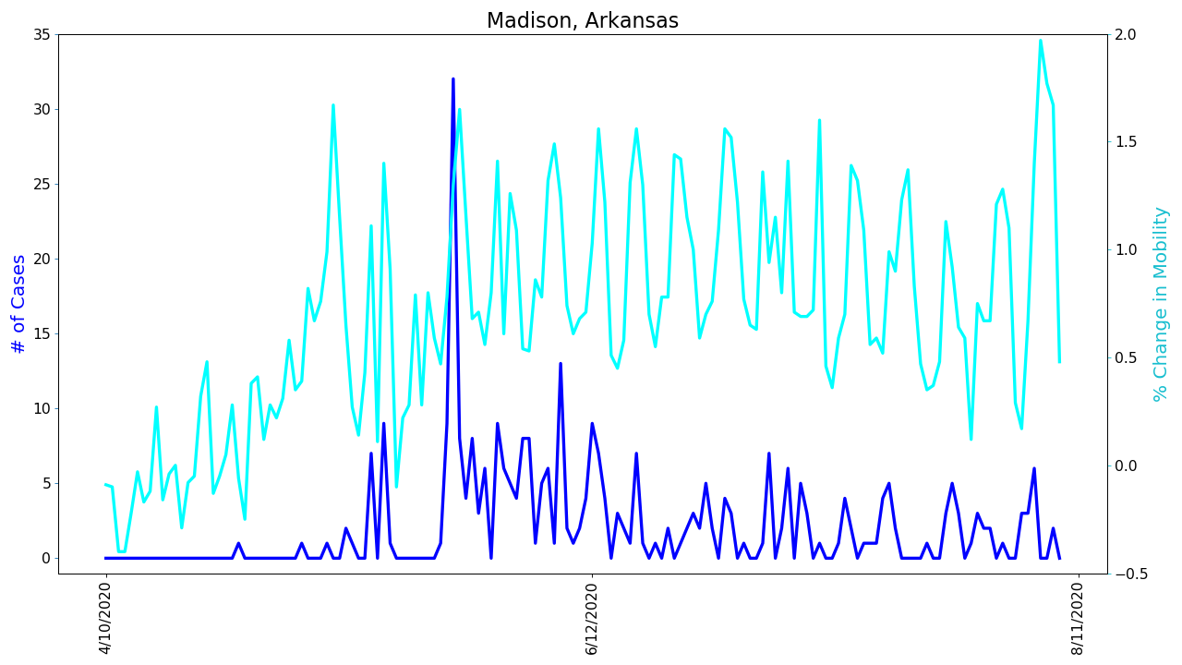
COVID Cases vs. Change in Mobility
Correlation, 0.31089593015299233
p-value 3.4926895684390565e-05
Correlation: 0.3494045435610098
P-value: 1.0239094628463903e-05)

Slide 14
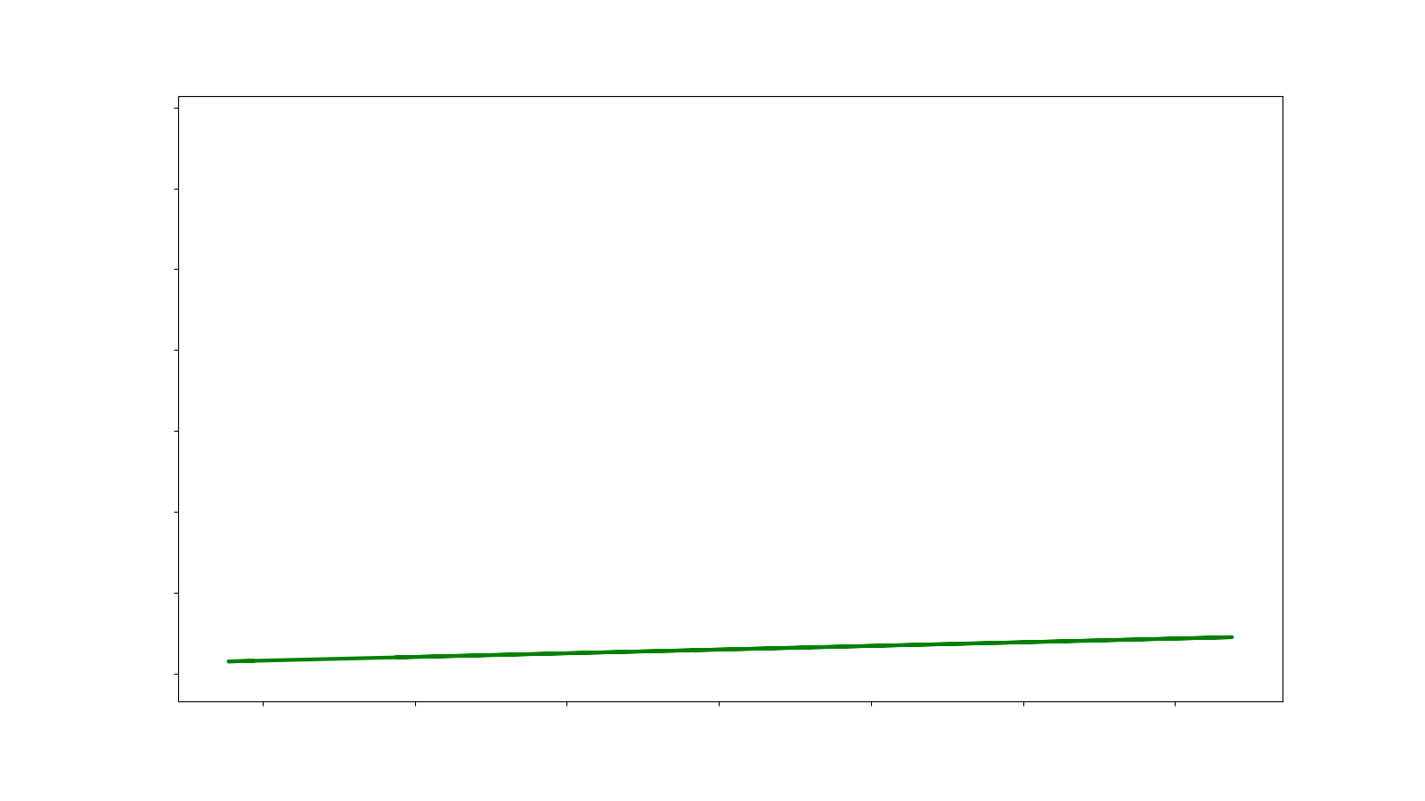
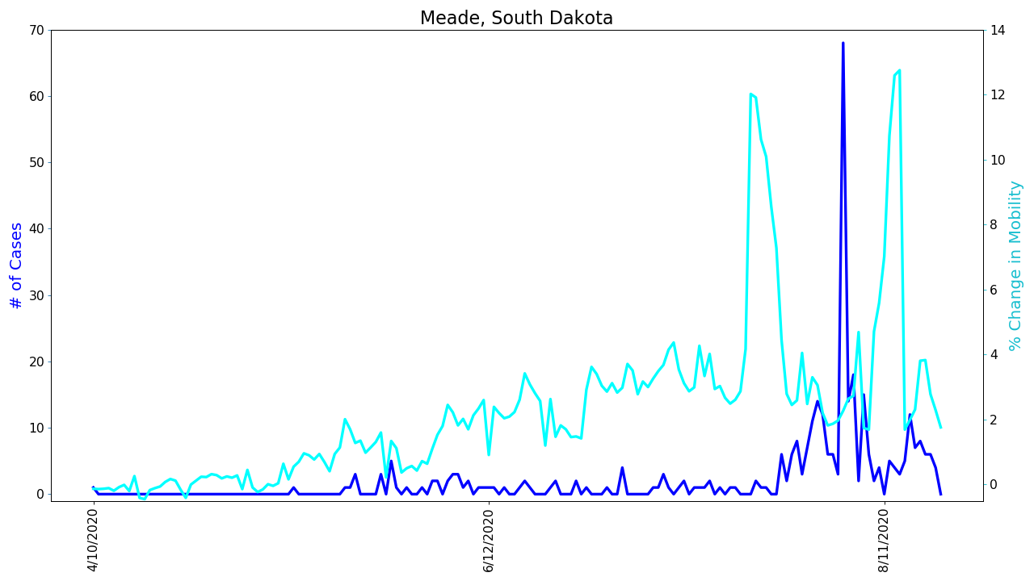
COVID Cases vs. Change in Mobility
Correlation:0.09443405293892815
P-value: 0.22619817706332274
 | Correlation coefficient (R2) | P-value
Tehema, California | 0.51 | 1.00E-05
Madison Arkansas | 0.35 | 1.80E-18
Sebastian Arkansas | 0.60 | 1-8E-18
Meade, South Dakota | 0.09 | 0.23
Bingham, Idaho | 0.31 | 3.50E-05
Could we be missing something?

Slide 15
The CDC advises that the incubation period for COVID could be up to two weeks. Let’s factor this into mobility rates….
 | Original Trend |  | Adjusted Trend
 | Correlation coefficient (R2) | P-value | Correlation coefficient (R2) | P-value
Tehema, California | 0.51 | 1.00E-05 | 0.56 | 1.70E-14
Madison Arkansas | 0.35 | 1.80E-18 | 0.28 | 5.50E-04
Sebastian Arkansas | 0.60 | 1-8E-18 | 0.67 | 7.80E-24
Meade, South Dakota | 0.09 | 0.23 | 0.52 | 4.80E-13
Bingham, Idaho | 0.31 | 3.50E-05 | 0.43 | 4.80E-13
Given (p -value <.05) in all cases, we fail to reject the null hypothesis. Conclusion – There was not enough evidence to disprove that rate of mobility is correlated with COVID case rate

Slide 16

Data Limitations Granularity of Data Reporting over Time Differing Geographies Different Time Elements Causal Elements Assumptions

Slide 17
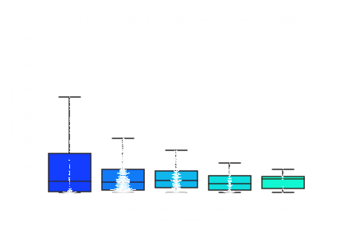
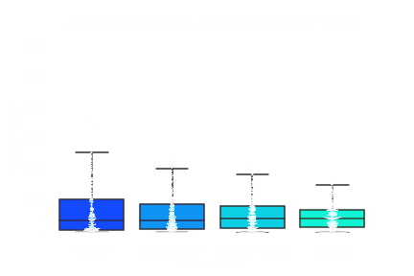
Florida Case Count by Median Income

Slide 18
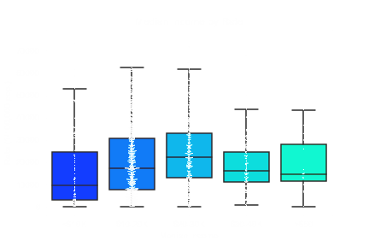
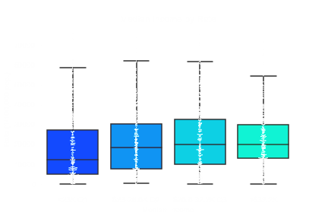
Florida COVID Rate by Rate

Slide 19
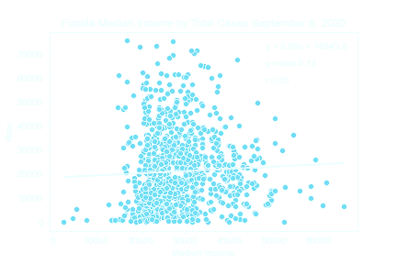
Florida COVID Rate by Median Income

